Slide 1
Joseph Rudigi Rukema
University of KwaZulu-Natal
The global threats of xenophobia and Racism
SOUTH AFRICAN CONTEXT
The world is witnessing growing level of intolerance against foreign labour migrants, refugee and asylum seekers.
South Africa is not unique
I will discuss labour migrant and refugees experience on xenophobia and Racism in South Africa and how both xenophobia and racism are embedded in daily economic and social situation of labour migrant and refugees in South Africa

Slide 2
xenophobia and Racism
Personal experience as migrant, related to studies conducted and daily interaction with refugees and labour migrants mostly from other part of Africa
JOURNEY TO SOUTH AFRICA
1. Labour migrant and Aasylum seekers followed diverse directions and used different means, including those who landed in Durban. Some followed rather long, risky and dangerous routes. While some of them came through Namibia ending up settling in Cape Town, others came via Mozambique and Swaziland and settled in Durban, and yet still others went through Zimbabwe and Botswana landing in Johannesburg. Others came by ship via Tanzania, with the aim going abroad, especially to Australia and in the United States. Many of those who used the ship as a mode of travel found themselves stuck either in Durban or Cape Town.

Slide 3
Factors attracting labour migrant and asylum seekers to SA
Both political and economic push factors as well as misleading information communicated through the mass media, often projecting only the attractive side of the marketed country.
“When I was still home, a friend of mine misled me. He told me that in South Africa, refugees are well looked after by the South African government and UNCHR. I had many expectations, especially to further my studies. When I arrived here things turned to be different. No assistance at all, police harassment is very bad around here, Home Affairs officials treat us like dogs. The only thing you get here is a paper. No shelter, no food, nothing at all. I’m very disappointed. If I should have known, I should have remained home. Now you see, I’m always fighting with people to cut their hair”

Slide 4
Exploitation in the journey
The journey to SA is border crossing which has led to migrants developing further tactics to ease the way.
There are some informal travel brokers called “Tindikere” both at the border gates and in the refugee camps, who assist them in crossing the borders in return for money. “Truck and taxi drivers” in return for money

Slide 5
Experience in SA
Settling in SA
Relationship can be either through ethnic line, religious or shaped by the social networks that go as far back as their previous knowledge of each other back at home.
In Durban, have established a number of committees based on ethnic lines. These committees help new comers to find a way and establish themselves in the city.

Slide 6
Public institutions
Key government institutions such as the Department of Home Affairs (DHA), which is supposed to assist migrant labour and asylum seekers, are perceived to be playing a negative role in the management of migrants.
“When you arrive at Home Affairs, the first question that you are asked is why did you come to South Africa and when are you going back. It really upset me, to see the way people are treated at Home Affairs. They do not consider us as human beings. They insult us and when they give you a paper, they give a paper just for three month renewable. You cannot get job with that paper”
Renewal of work permit (bureaucratic process)
Financial institution

Slide 7
Exploitation by local South Africans is another abuse that migrants have to endure as captured in the following response by one respondent,
“My brother we are slaves here, we do not only have chains in our necks, but we are not different from those slaves in the United States of America. Imagine, I’m a Pastor and have an Honors degree in economy from Belgium University and working as a car guard, where I earn R60 per day on regulated hours, from 8 am to 4pm and the boss comes and takes R25 from my R60 … that is for rape of my dignity. How much do I remain with? Just tell me my brother R45, R45? While I have to pay transport and my lunch, how much would I remain with? My brother we are slaves here. If I don’t report to work, even if I’m sick then I will be fired while they don’t pay me and just come to collect the little money that I begged from people in the parking lots”

Slide 8
Most of migrant are employed in exploitative Jobs. i.e. car guards, security guard
Self employment
Hair dressing, street vending
Challenges faced: Obtaining permits
Harassment by city official and police
“Every time, the police comes here and asks us paper, if we shown them this paper, they tell us that we are not allowed to work here and they take our belongings. And they say that we are making the town dirty. Some time they come here and ask us to cut their hair for free. We can not refuse, if you refuse they will come back next time and harass us”

Slide 9
Despite being self employed, most of them experience difficulties in accessing banking facilities. They cannot even generate enough income to send money back home to their families. Banks dealing with transactions do not allow them to send money as they claim that they need to produce proof as to where they got the money from, and a valid identity document ignoring the fact that some refugees rely on informal jobs for living.
Xenophobia and Racism
Most of participants reported to have experience one or both xenophobia and Racism
i.e. derogative words, labour conditions (exploitation)

Slide 10
SELF EXCLUSION
There is an apparent mistrust between migrant and local which has led to self exclusion on the part of migrants
Q/ What have they done to you that you do not trust them
R/ “My friend told me that they are not good people. They have not done anything to me, but these people are not good. They hate us”.

Slide 11
Need for empowerment
MIGRANTS
Encourage migrant not to view themselves as victims, but empower them with knowledge and skills (their rights) necessary skills for survival (i.e. self English)
Build strong grass roots network and structure among migrants
Building network with existing institutions (Union, Human rights, advocacy group etc)
INDIVIDUAL
Every person to contribute better the condition of migrant

Slide 12
Labour organisations
Advocacy in creating conducive economic and political condition in home country
Establish solid partnership between migrants and labour organisation
Educate migrant on their rights and obligations
Establish partnership with public institutions

Slide 13
Personal contribution
Established Language school where migrants and refugees are taught basic English for survival (SA)
Established a University (DRC)

Slide 14
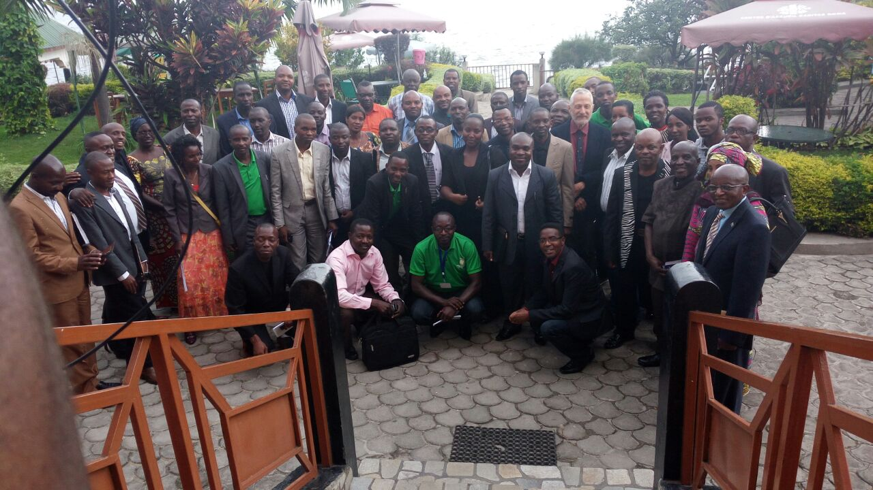
Regional conference on Peace Building in the Great Lakes Region September 2015

